Slide 1
Employer Panel Discussion
Friday 14th June 2019

Slide 2


Our Purpose
SE2
Service – End to End
Service – End to End
Who is SE2?
BPO & More
Notes:
Understanding what we do, how we serve our clients, really defines our name.
We offer service from the inception of a product throughout the life of a life insurance or annuity product.
Service- end to end…

Slide 3

The Realization of SE2
2003
2005
2000
SE2 Launches
Could there be segregated
functionality &“multi-tenancy”?
Would this benefit other companies?
Notes:
In approximately 2000 SB leaders asked determined it would be beneficial for other life insurance and annuity companies.
Between 2002-2005, the technology team members began modifying and testing for segregated functionality – could data be separated? – And could the separation of data allow for multi-tenancy. – For instance: Can multiple companies use the system and keep data separate from other companies’ data.
Leaders determined it could. The realization that the technology framework could be used industry-wide laid the foundation for this separate company.
At this time we have scalable technology - our unique multi-tenant platform drives down per policy cost.
In 2005, se² was incorporated as a separate entity.
Our first client was Goldman Sachs.
Our Name: Our name means “Service End to End” – Service from a product’s inception through-out the life to the product.

Slide 4

















Why our many Clients Use Us
Achieve Transformation Benefits with Lower Risk
Support Distribution
Reduce Unit and Overall Costs
√
Launch New Products Quickly and Efficiently
Flexible Scalability
Improve Persistency
Reduce Compliance Risk
Improve
Profitability
Product Launch
Reduce Conversion Risk
Reduce
Risk
Electronic Processing
Reduce Reserve Requirements
Improve Speed to Market
Modernize Technology / Retire Systems
Improve Customer Service
Improve
Service
Positioning
for Success
Improve Distributor Experience
Focus on Core: Product, Distribution, Risk Management
Ability to Scale
Notes:
Because of our multi-tenancy and our technology being specifically tailored to life insurance products, we provide our clients with five distinct reasons for choosing us.
We improve service. Our teams and training are dedicated to higher/better levels of support. Teams can share knowledge and skills, trainers can be dedicated.
We improve profitability. We reduce unit and over costs and reduce reserve requirements.
We reduce risk. Any type of change creates amounts of risks. Our technology and personnel are customized and dedicated to ensuring risk reduction.
We help launch products quicker and more efficiently. Our flexible technologies and electronic processing allow for speed to market.
We help our clients position for success. We have modern technology, the ability to scale and we are solely focused on product, distribution, and risk management.

Slide 5




Our Market Positioning
Help clients launch new annuity products faster
Up to a third faster and at a third less cost than over-taxed internal teams and outmoded legacy systems
Continue to grow annuity block with new conversions
Leverage our market leadership to grow annuity block of business
Invest in new Digital & Life capabilities
Leverage capital investment and vendor echo system to build the industry disrupting “No Touch” Digital Life platform
Grow Life block with strategic partnerships and anchor clients
Be selective on partnerships around Life to anchor clients and strategic partnerships

Slide 6
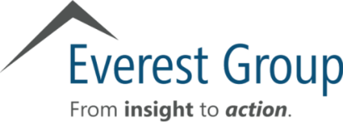




Industry Analyst Recognitions
2016
2017
2017
2018
2018
Recognized as a Leader in NelsonHall's 2016 NEAT Vendor Evaluation for Life, Annuities and Pensions BPO
Named both a ‘Leader’ and a ‘Star Performer’ in Everest Group PEAK Matrix™ Assessment Report 2017 for Life and Pensions Insurance BPO
Named Industry Visionary on Gartner’s 2017 Competitive Landscape: IT Service Providers to the Global Insurance Industry Report
Recognized as a High Performer on the HFS Research’s Industry Blueprint: Insurance Operations Services 2018
Positioned strongly for capabilities across both life insurance and annuities in 2018 Novarica Market Navigator BPO-BPaaS Report

Slide 7
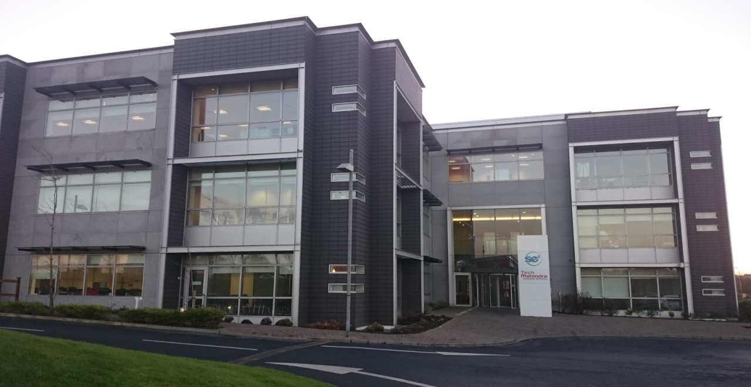
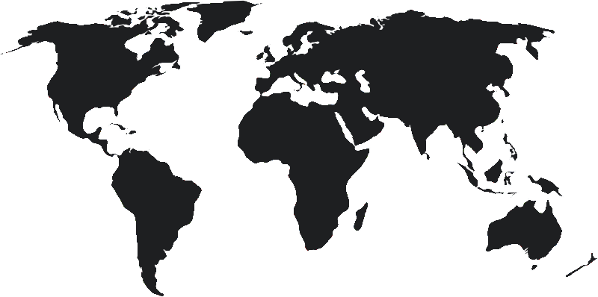
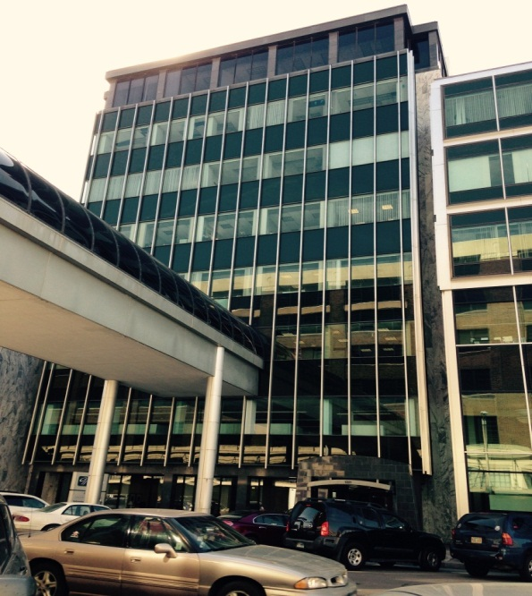
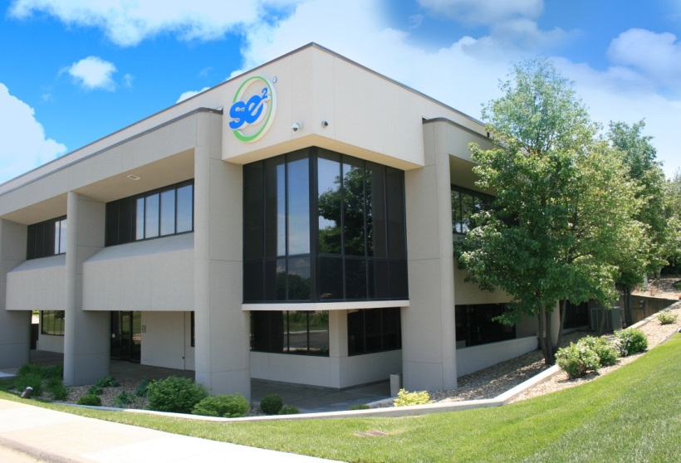
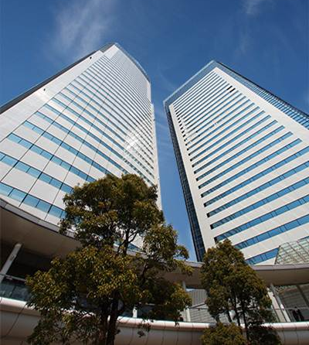
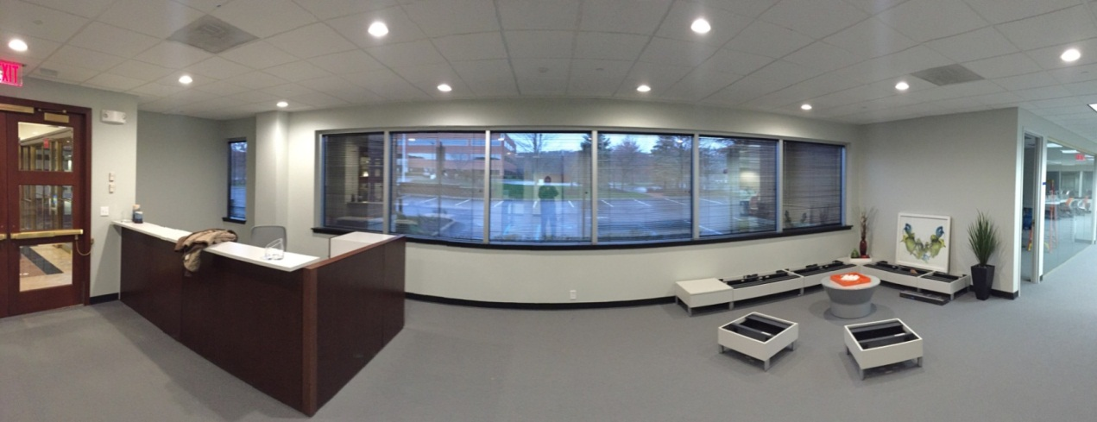
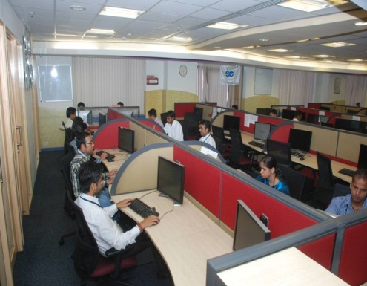
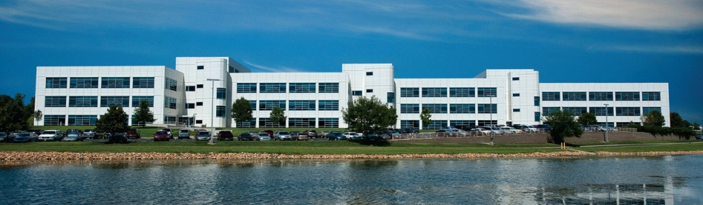
SE2 Global Delivery
Processing Center
107 Total Associates & Managers
*73IT Professionals
*30 Call & Processing
2 Finance and Admin.
1 HR Manager
1 Learning & Development
Acquired Fall 2015
100 Delivery Associates
1 Office Manager
Opened December 2015
12-15 Lincoln Benefit Life Call Center Associates
Established February, 2015
Two Locations
IT Staff Augmentation
Disaster Recovery
Processing Center
Corporate Headquarters
Lincoln, Nebraska
Mid-West
Waterford, Ireland
Bridgewater, New Jersey
India
Topeka, Kansas
Notes:
Our home is in Topeka, Kansas where we have two separate locations. Corporate Home Office located at 1300 Arrowhead. Referred as Arrowhead or even 1300. Its houses leadership and some call/processing teams as well as many support teams. This small building houses less than 10% of our associates.
Security Benefit Building – also known as SB Main Campus or 6th Street Campus. This large campus features a café, training center, and more than 70% of our associates. Our parent company is Security Benefit. We rent space and take advantage of the it’s size to accommodate many of our needs.
Other locations include:
Se2 – Lincoln Nebraska – This particular site houses a call and process center specific to only to Lincoln Benefit Life. It’s directly north of Topeka. Driving time would be about three hours. Lincoln Benefit Life requested that their call and processing center be housed near their home location.
Se2- Bridgewater – Located in Bridgewater, NJ is another recent addition. In late 2015 se2 chose to secure a location central to the Life Insurance industry. Located near Bridgewater are many Life Insurance companies. In this location, we are a presence in the Industry, tap into local talent found in this area, and court many potential new clients.
Se2 –Waterford – Located in Ireland. Se2 purchased the entity in late 2015. This group of highly skilled personnel helped onboard one of our clients to the se2 platform. This location also helps support our 24/7 global delivery model.
Points of interest:
Kansas City, Missouri - houses a business continuity and disaster recovery location.
NTT – located in India. se2 has engaged NTT Data, Inc to provide transaction, reporting, and accounting support services. Although they are not se2, they are business

Slide 8



Background to the Waterford Site
1998
2013
2015
Sun Life launches an offshore
location in Waterford, Ireland
Delaware Life purchases Sun Life’s
life and annuity block of business
Ireland team converts
Block to se²’s systems
se² purchases Waterford Operation
Notes:
Omit slide if presenting to non-Ireland groups.
1998 Operations in Waterford launches with 400 IT and Operations Staff working on life, annuity, and group platforms for Sun Life Financial.
2013: Delaware Life owned by Guggenheim partners purchases Sun Life’s Annuity and Life Insurance block of business in 2013.
The Waterford team helps convert the block of business to se2’s systems.

Slide 9






SE2 Ireland Roles and Purposes
Project Management
Production Support
Requirements
Development
Testing
Design

Slide 10
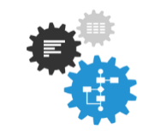
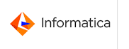






THEMES
ENABLERS
Digital Themes and Technology Enablers Driving the Journey Towards Digital Administration at SE2
Digitization
Automation
Analytics
Omni Channel
Real Time
Self Service
Services / APIs
No / Low Touch
Reduce Processing Time
Business Insights
User Personalization
Next Best Action
Additional Digital Tools & Technologies
Robotics
Rules Engine
Application Integration Network
Workflow
MuleSoft

Slide 11
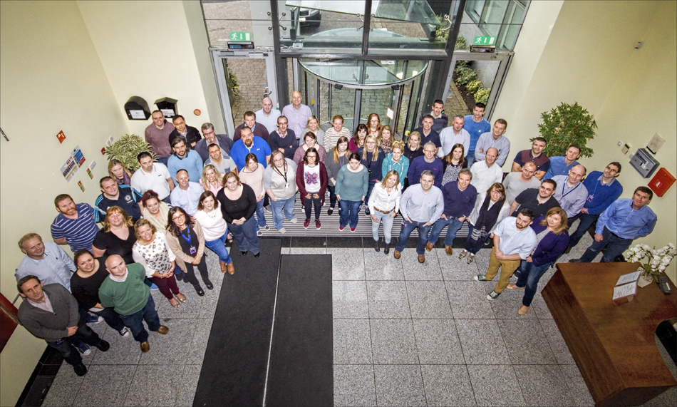
Waterford Office
110 Total Associates & Managers
*75 IT Professionals
*32 Call & Processing
1 Finance and Admin
1 HR Manager
1 Learning & Development
Notes:
Questions
Break

Slide 12
What has SE2 ever done for me?
An introduction role in IT
Training and Development
Mentoring
Travel
A growing company
Working in a multi-national, multi-site organisation all in beautiful Waterford

Slide 13
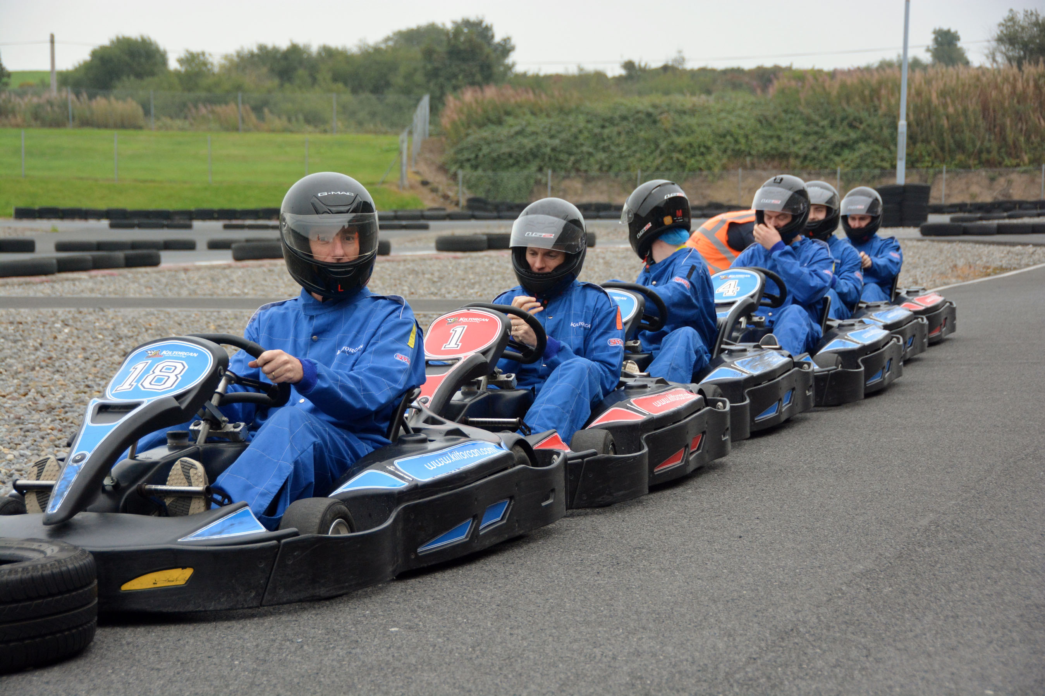
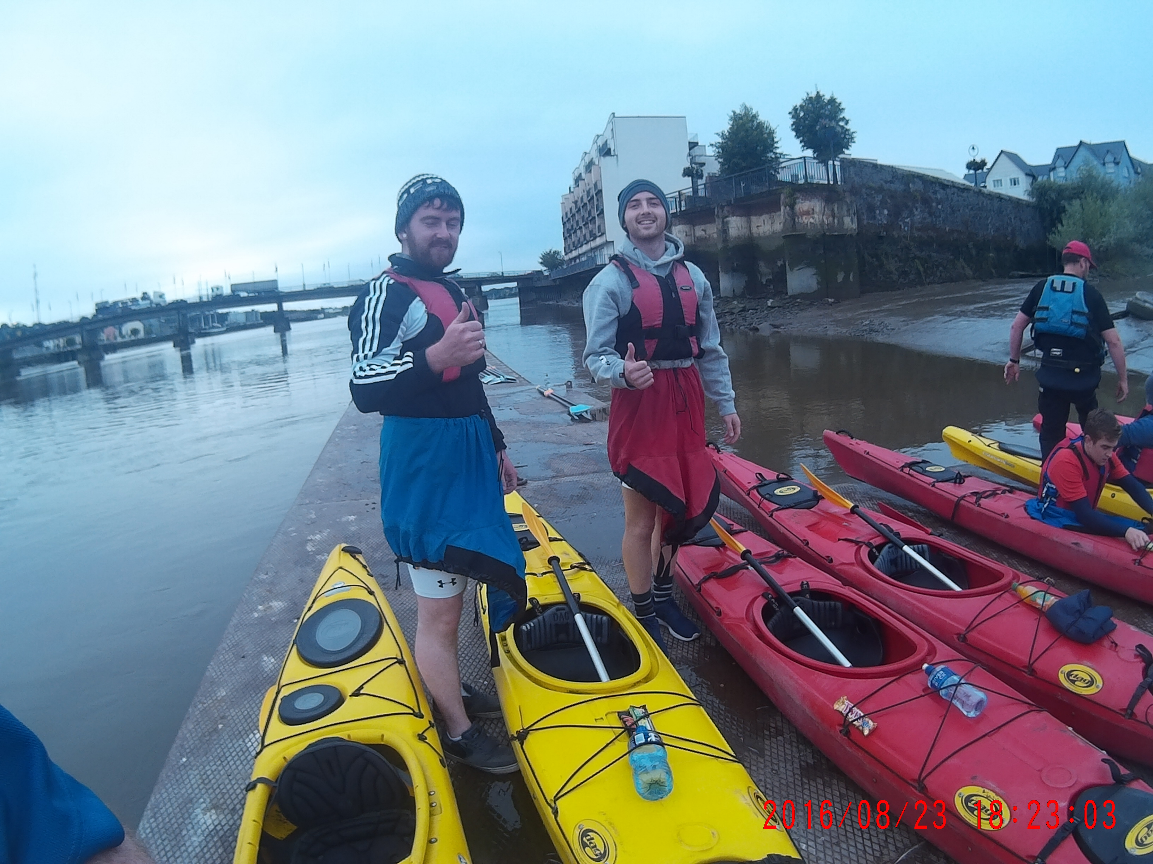
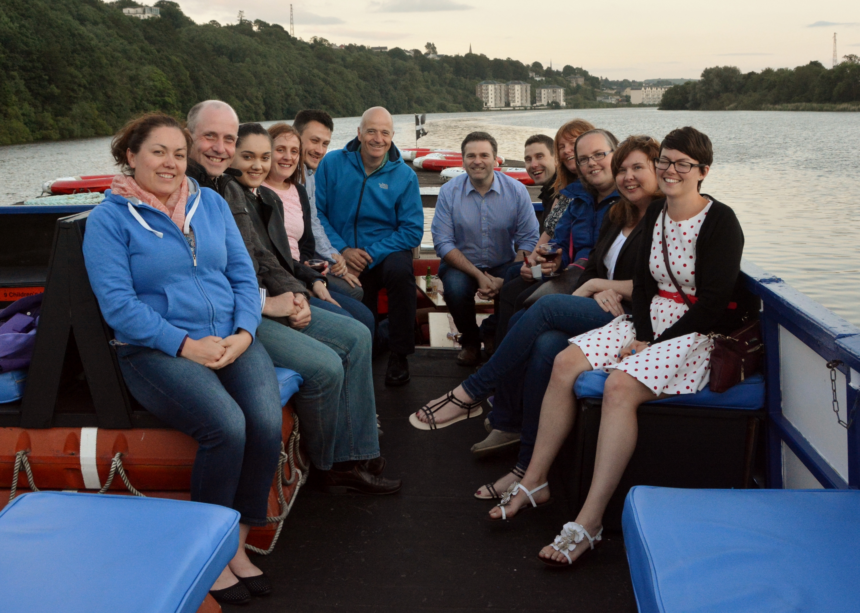
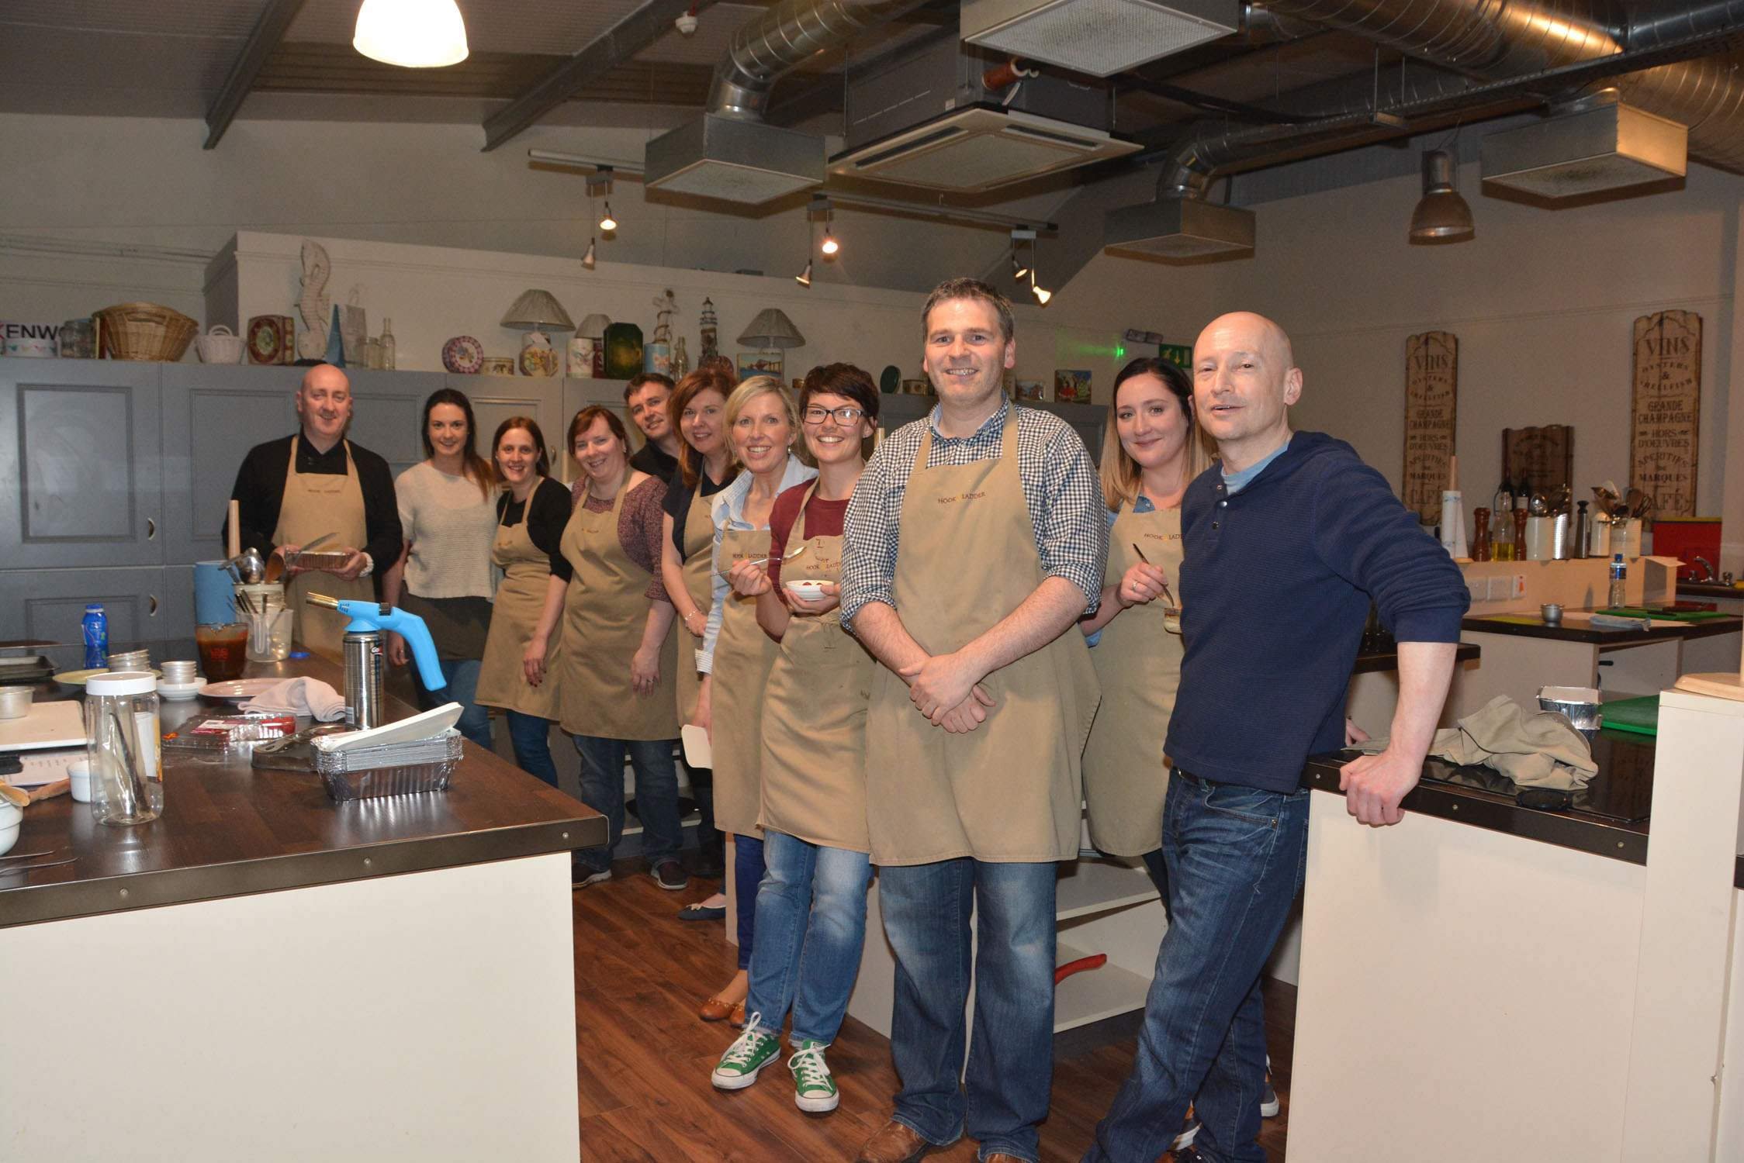
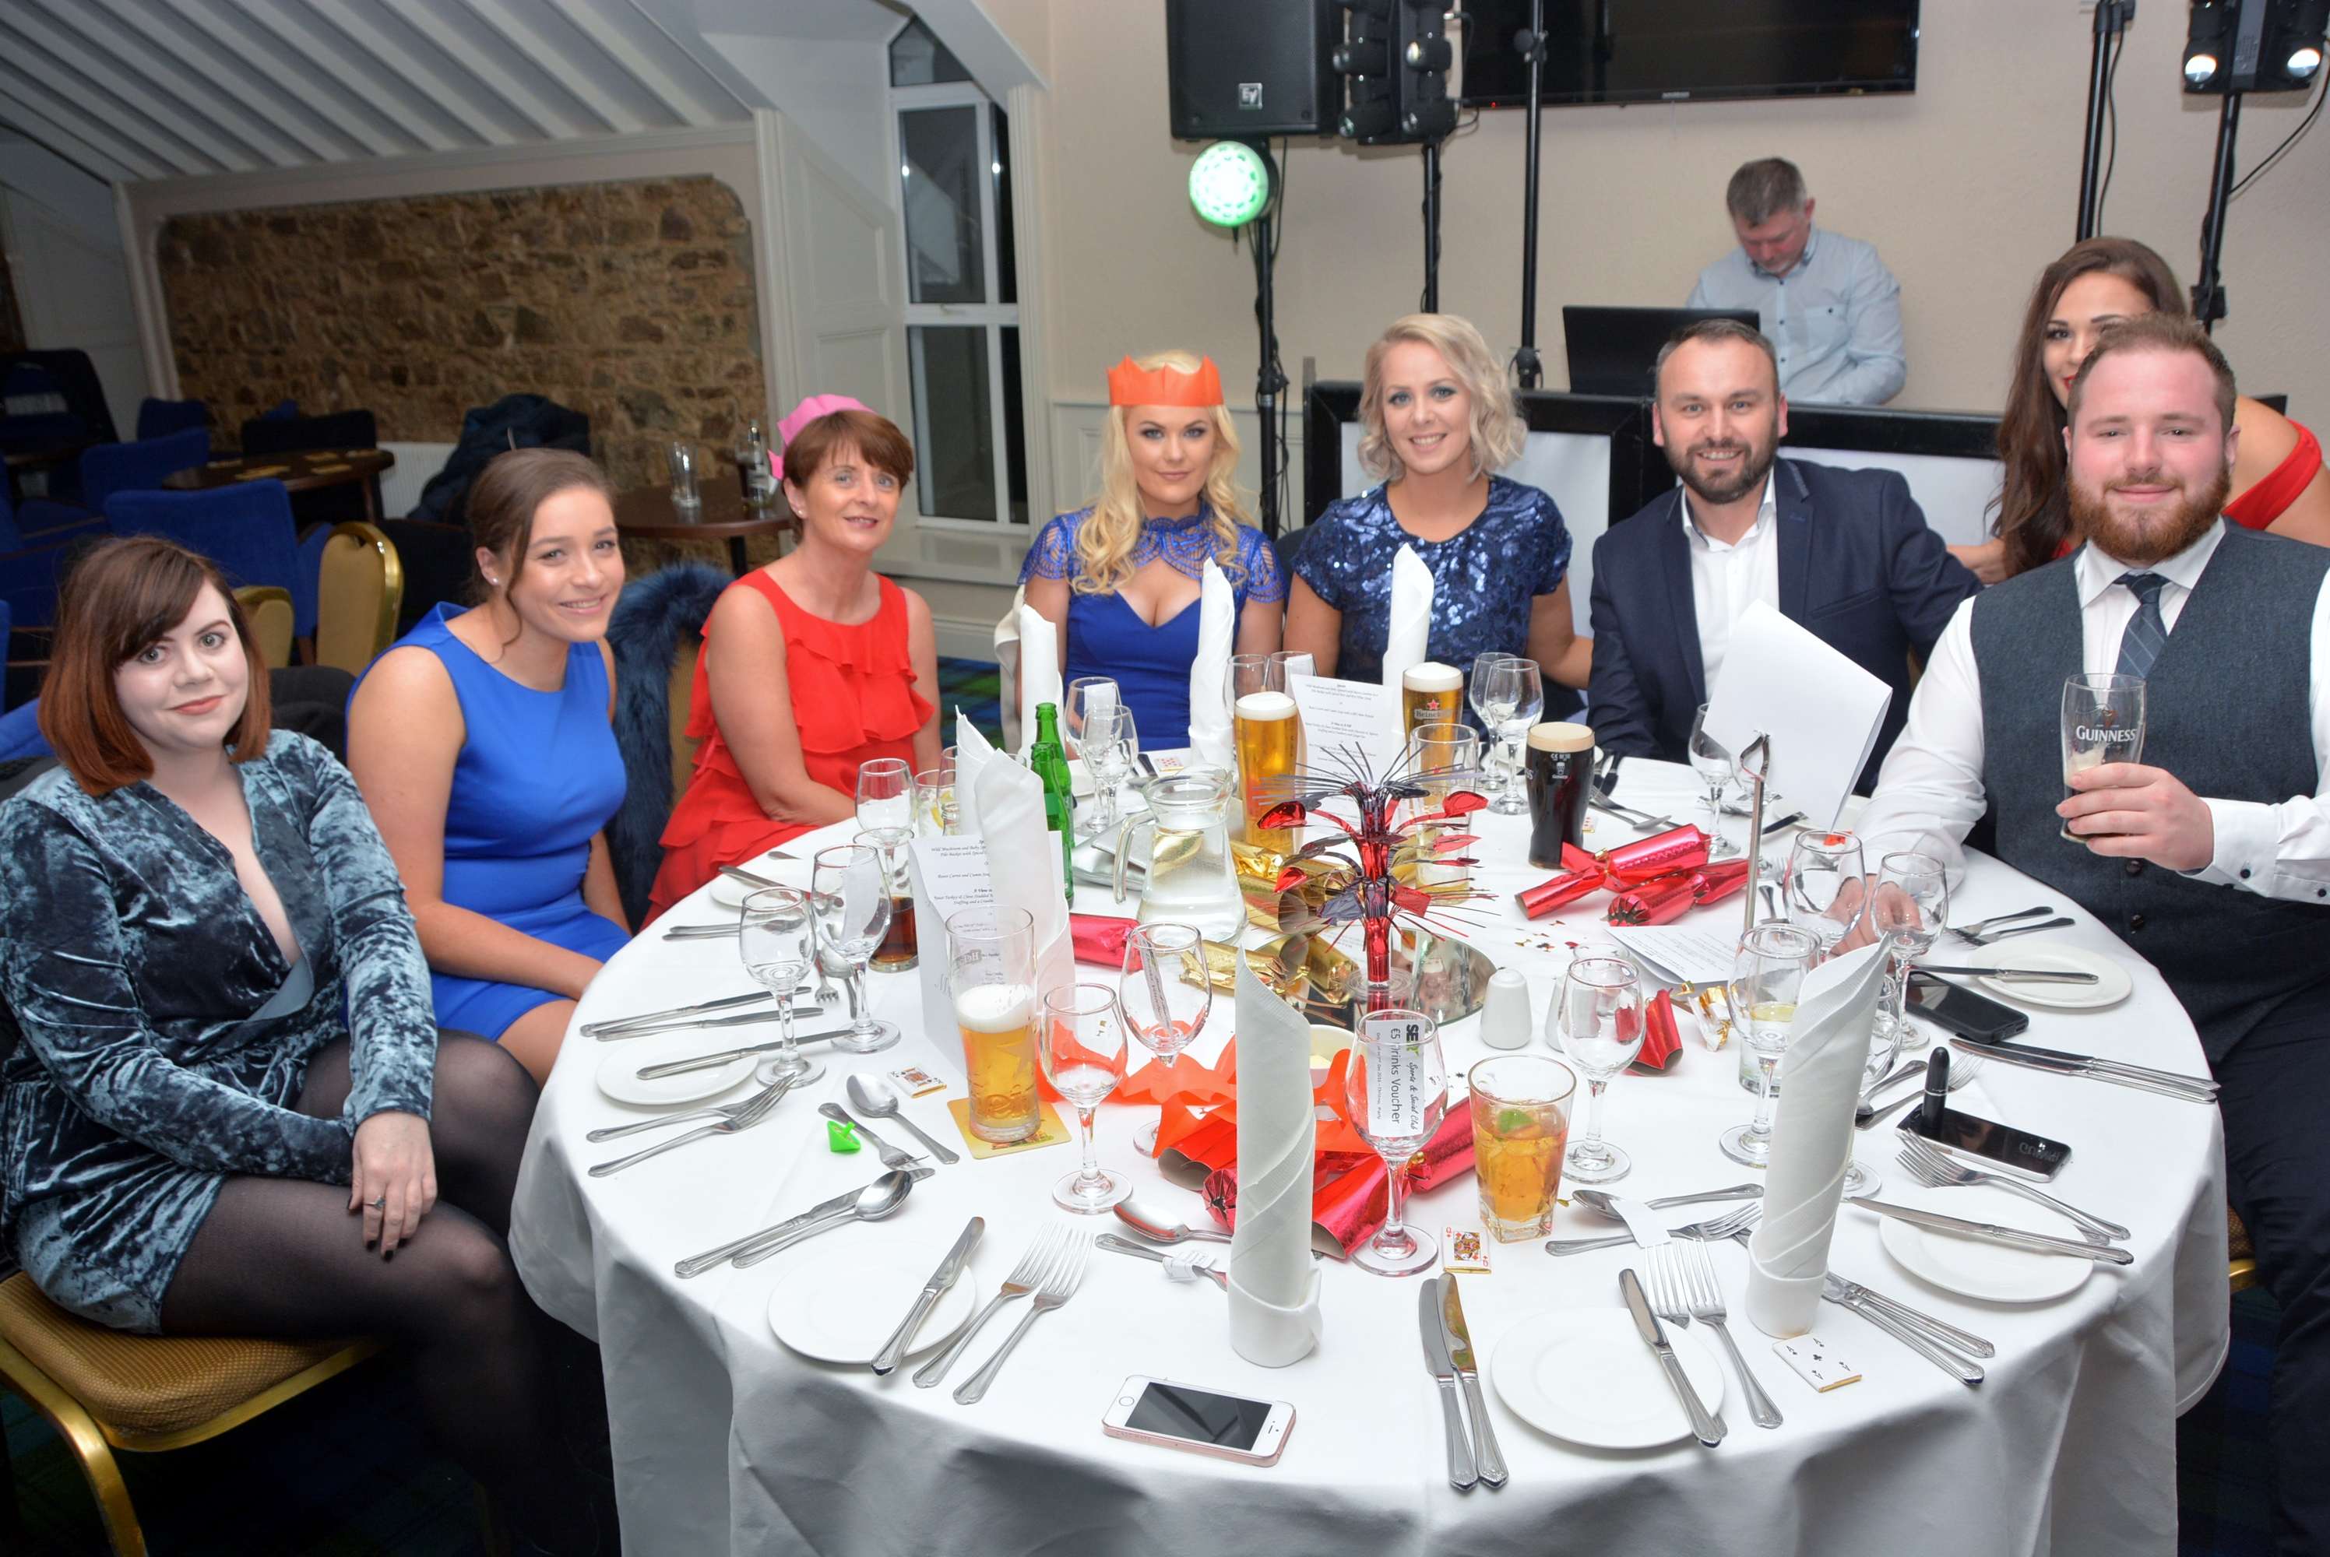

Sports and Social Events

Slide 14






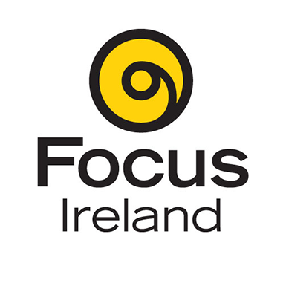

Corporate Social Responsibility
SE2 has sponsored the following events:
We also donate thousands of euro each year to local and national charities:
Notes:
Sponsors
Winterval
Waterford Harvest Festival
Waterford Viking Marathon
Tramore Promenade Festival
Donate to:
Irish Cancer Society
Solas Centre
Focus Ireland
Waterford Hospice

Slide 15

Further Education with WIT
SE2 works closely with WIT ensuring that modules are relevant and meet the demands of our business and ever changing technologies. 75% support.
Many of our employees have completed/are currently completing:
MSc in Computing in Enterprise Software Systems
HDip in Computer Science
HDip in Business Systems Analysis

Slide 16
Thank You

